Slide 1



Rust for Parallel and Concurrent Programming
Murariu Tudor-Cristian

Slide 2
Introduction
Rust is a modern systems programming language.
Focuses on performance and memory safety without a garbage collector.
We'll explore how Rust handles parallelism, compare it with other languages, and highlight real-world use.

Slide 3

General Presentation of Rust
Developed by Mozilla, now maintained by the Rust Foundation.
Designed for performance and safety
→ No garbage collector, deterministic behavior.
Memory safe by default
→ Eliminates nulls, dangling pointers, and data races.

Slide 4

Rust and Parallelism
Rust provides multiple safe and performant models for parallelism:
  Threads: Low-level control via std::thread
  Async/await: For lightweight, non-blocking concurrency
  Data parallelism: Using the rayon crate for parallel iterators
  Channels: For message passing between threads

Slide 5
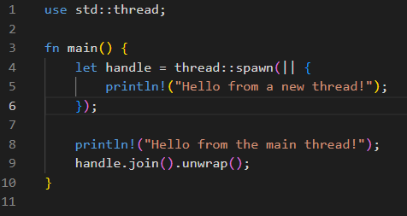
Threads in Rust
Threads are created using std::thread::spawn.
Values can be moved into threads safely.

Slide 6
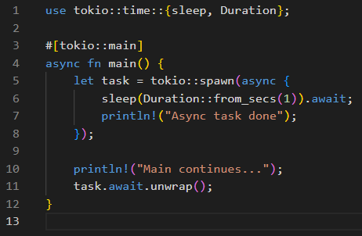
Async Programming in Rust
Rust supports async/await for I/O-bound concurrency.
Requires an async runtime like tokio or async-std.
Efficient task scheduling with zero-cost futures.

Slide 7
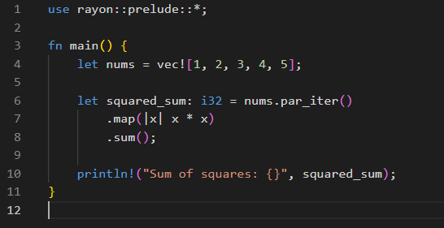
Data Parallelism with Rayon
The rayon crate allows easy parallel iteration.
Drop-in replacement for standard iterators.
Safe, performant, and ergonomic.

Slide 8
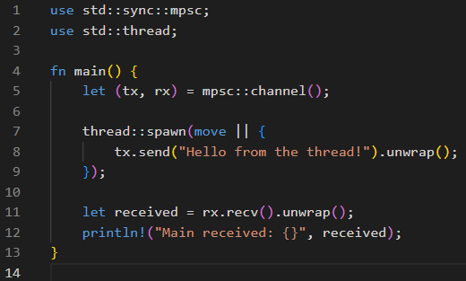
Message Passing with Channels
Rust provides channels in std::sync::mpsc for safe communication between threads.
mpsc stands for multiple producer, single consumer.
Threads communicate by sending values across a channel instead of sharing memory.
Ensures synchronization without data races.

Slide 9
Comparison with Other Languages
Rust stands out by combining C++-level performance with Go-like safety. Here's how it compares on key aspects of parallel and concurrent programming:
Feature | Rust | C++ | Go | Java
Memory Safety | ✅ | ❌ | ✅ | ✅
Garbage Collector | ❌ | ❌ | ✅ | ✅
Data Race Prevention | ✅ | ❌ | ✅ | ✅
Zero-cost Abstractions | ✅ | ✅ | ❌ | ❌
Async/Await Support | ✅ | 🔶 (C++20) | ✅ | ✅

Slide 10

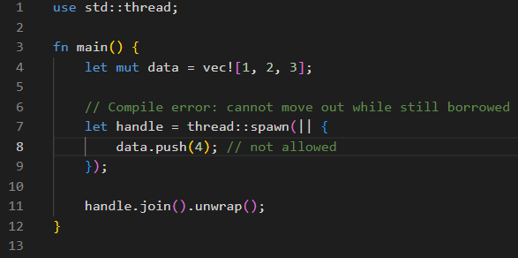
How Rust Prevents Data Races
Rust uses its ownership and borrowing system to statically (at compile time) guarantee:
  Only one mutable reference to data can exist at a time.
  Or: many immutable references, but no mutable one at the same time.

Slide 11
Thank you
Murariu Tudor Cristian

